Slide 1

St. Francis Institute of Technology Department of Computer Engineering
Project Title: Glaucoma Detection and Classification
Group Members:
Royce Dcunha 37
Aaron Rodrigues 38
Manisha Sahu 43
Cassandra Rodrigues 54
Name of the Guide: Dr. Kavita Sonawane

Slide 2
Contents
Introduction
Literature
Problem Statement
Proposed Solution
Work Flow of the system
Algorithm with Implementation details
Experimental Setup
Data Set
Performance Evaluation Parameters
Validation with Test Cases
Results & Discussion
Conclusion
References

Slide 3
Introduction
Glaucoma is a chronic eye disease that results from visual nerve damage caused by intraocular pressure in the eye.
According to the World Health Organization (WHO), glaucoma affects more than 65 million people around the globe.
In the early stages of glaucoma, there are no symptoms of vision loss, but as it progresses, it may result in irreversible blindness.
It is often associated with an accumulation of pressure within your eye.
Glaucoma is common among families. It usually happens later in life.

Slide 4
Introduction
Diagnosis of glaucoma in the clinical environment includes intraocular pressure measurement, visual field testing, or examination of the optical disk of fundus images.
The majority of people have no symptoms. If symptoms occur, it is usually around the end of the illness. That's why glaucoma is often called the "sneaky vision thief". The primary sign is generally a loss of lateral vision or peripheral vision.
There's no way to prevent glaucoma. But if you find it early, you may reduce your chance of eye damage. Therefore, one should carry out regular eye examinations and follow doctor's instructions.

Slide 5
Literature
This paper studied by C. Sharmila and N. Shanthi [1] uses Transfer learning which is a machine learning method where a model developed for one task is reused as the starting point for a model on a second task and is mostly used to improve accuracy.
The pre-trained model Inception V3 is employed as transfer learning for glaucoma diagnosis.
Transfer learning with both feature extraction perspective and fine-tuning procedure is used. Adam, an optimization algorithm has been utilized to optimize the network weights.
The model predicted two classes (glaucoma and non-glaucoma)with a test accuracy of 91.36%.
The performance of the automatic glaucoma diagnostic system is analyzed by sensitivity, specificity and accuracy metrics. 82.60% of sensitivity and 95.30% of specificity have been achieved.
A strategy is needed to carry out the study using additional dataset in the near future in order to improve the accuracy of the automatic glaucoma detection algorithm.

Slide 6
Literature
Arkaja Saxena, Abhilasha Vyas, Lokesh Parashar, Upendra Singh [2] state that Glaucoma is a disease that relates to the vision of the human eye.
This disease is considered as the irreversible disease that results in the vision deterioration.
This paper presents architecture for the proper glaucoma detection based on the deep learning by making use of the convolutional neural network (CNN).
The CNN provides a hierarchical structure of the images for differentiation.
Proposed work can be evaluated with a total of six layers.
Here the dropout mechanism is also used for achieving the adequate performance in the glaucoma detection.
The datasets used for the experiments are the SCES and ORIGA. The analysis is performed for both the dataset and the obtained values are . 82.2% and 88.2% for the ORIGA and SCES dataset respectively.

Slide 7
Literature
Ali Serener, Sertan Serte [3] studied Transfer Learning for Early and Advanced Glaucoma Detection with Convolutional Neural Networks
This paper uses deep convolutional neural networks to detect early and advanced stages of glaucoma on fundus images.
The proposed model is performed on fundus images using two deep learning methods, ResNet50 and GoogLeNet.
The performances of the two models are evaluated in terms of accuracy, sensitivity, specificity and the area under the ROC curve.
The results show that for early, advanced as well as overall glaucoma detection GoogLeNet outperforms ResNet-50.
The accuracy performance of this classification for ResNet50 is 0.86, the sensitivity is 0.21, the specificity is 0.93. On the other hand, the performance accuracy of this classification for the GoogLeNet model is 0.85, the sensitivity is 0.29, the specificity is 0.91.

Slide 8
Sr. No | Algorithm | Advantages | Datasets | Limitations | Accuracy | Performance Evaluation Parameters
1. | Inception V3 (2021) | Uses techniques to classify early and advanced glaucoma. | ORIGA | Not Mentioned | 91.36% | Sensitivity: 82.60% Specificity: 95.30%
2. | Convolutional neural network (CNN) (2020) | Higher Detection capability, Achieved high accuracy. | SCES, ORIGA | Accuracy differs according to the dataset. | Accuracy between 82.2% to 88.2% | Sensitivity: 0.21 to 0.29 Specificity is 0.91 to 0.93
3. | GoogleLeNet and ResNet (2019) | Approximately one million images of ImageNet dataset are used to pre-train these models. | RIM-ONE | Not mentioned | 85% to 86% | Sensitivity= 0.21 to 0.29 Specificity=0.91 to 0.93 ROC= 0.74 TO 0.75
4. | CNN + LSTM (2021) | Reduced glaucoma prediction time, High accuracy | RIMONE, DRISHTI-GS, DRIONS-DB | Cannot be trained without a labelled dataset. | Around 90% | Sensitivity= 95.4% Specificity= 96.7% AUC = 0.984
5. | MobileNet and Inception V3 (2021) | Improvement in Accuracy | ORIGA, SCES | A few cases that were misdiagnosed in terms of distributed colors and shapes | 0.86 for MobileNet 0.90 for Inception V3 | Precision= 0.87 to 0.90 Recall = 0.87 to 0.90 F1 score= 0.87 to 0.90 AUC = 83.1% to 88.7%

Slide 9
Sr. No | Algo Name | Advantages | Datasets | Limitations | Accuracy | Performance Evaluation Parameters
6. | Inception v3 (2021) | Reduced glaucoma prediction time, High accuracy | ACRIMA, LAG | Cannot be trained without a labelled dataset. | 85.29% | Sensitivity= 95.4% Specificity= 96.7% AUC = 0.984
7. | AlexNet, SVM (2020) | Combining CNN and SVM resulted in greater accuracy than low-performance extraction methods. | HRF, Origa and Drishti_GS1 | Not mentioned. | 91.21% | Specificity:90.8%, Sensitivity: 85%
8. | VGG, ResNet (2021) | Uses forward and backward propagation to obtain the best weights with the lowest loss for the best performance | LAG | Not mentioned. | 80 to 87% Best Accuracy: 86.9% | Precision: 86.9% Recall: 86.9%
9. | MNet and DeNet (2019) | DeNet produces the glaucoma detection result from the image directly without segmentation. | ORIGA,SCES | Accuracy and AUC can be improved. | Around 85% | AUC (0.8998 to 0.9183) Sensitivity(0.7609 to 0.8478) Specificity(0.8706 to 0.8380)

Slide 10
Sr. No | Algo Name | Advantages | Datasets | Limitations | Accuracy | Performance Evaluation Parameters
10. | VGG 16, VGG 19, Inception V3, ResNET 50, Xception (2019) | 1.Uses huge amount of unlabeled data 2.The architecture of the classifier is less complex. | ACRIMA and Public databases | Performance decreased when testing the CNN on databases different from those used for training | 90.17% | 1.ROC curve(0.831) 2.AUC= 0.9605 3.Specificity (0.8580) 4. Sensitivity(0.9346) 5.F-score (0.8429)
11. | UNet, and EffcientNet (2022) | Higher Accuracy, Improved Efficiency | DRISHTI-GS, RIM-One | Accuracy differs according to the dataset. | Not mentioned | Dice Score = 0.96 Intersection Over Union ( IOU) = 0.91
.12 | AG-CNN (2019) | Used attention maps to improve the detection and pathological area localization. | LAG,RIM-ONE | 1.Requires preprocessing and post-processing 2.Need to extract individual channels for segmentation. | 85.2 % to 96.2% | Sensitivity= 84.8% to 95.4%,Specificity=85.5% to 96.7%,AUC =0.916 to 0.984,F2 Score= 0.837to 0.954

Slide 11
Challenges
Diagnosis of glaucoma in earlier stages is important to prevent further vision loss.
The number of ophthalmologists required for evaluation by direct examination becomes a limiting factor due to ageing, population growth, physical inactivity and obesity which contributes to increase the risk of vision loss.
However, in large-scale screening scenario, these manual assessments are not precise, mostly in developing countries due to the insufficiency of trained experts and scarce modern imaging equipments.
30/04/2022
Glaucoma Detection and Classification

Slide 12
Problem Statement
Glaucoma is a neuro-degenerative eye disease that develops when the intraocular pressure inside the retina rises too high.
It is the second leading cause of blindness in the globe and if not detected early enough, it can lead to complete blindness.
There is a critical need to build a system that can function successfully without the use of specialized equipment or medical practitioners, and that is also less time demanding.

Slide 13
Proposed Solution
Several models are being studied for the glaucoma detection.
The models chosen are: VGG19, VGG19+LSTM, InceptionV3, and InceptionV3+LSTM.
Every model is being worked with the use of K-fold cross validation and data augmentation to overcome the limitation of small dataset and the performance parameters values obtained are then compared.
Finally, classification is done based on these features and the input image is predicted to be either glaucomatous or healthy.

Slide 14
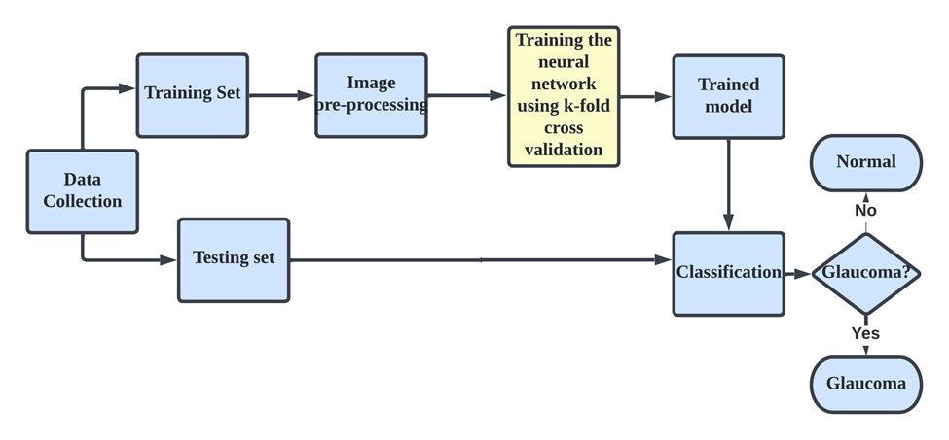
Work Flow of the system

Slide 15
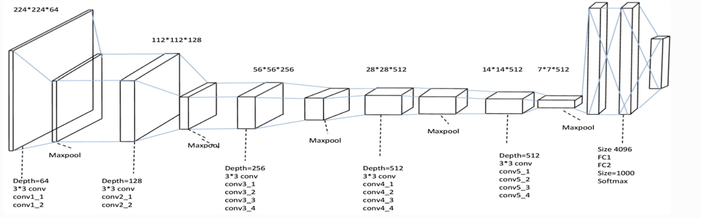
Algorithm with Implementation Details
Sigmoid
Fig 3: VGG19 Base Model

Slide 16
Algorithm with Implementation Details
VGG 19:
VGG 19 is a convolution neural network that is 19 layers deep.
It consists of 16 convolution layers, 5 MaxPool Layers, 3 Fully connected Layers and 1 sigmoid Layer
The first 16 layers have convolution and max pooling layers and are used for spatial feature extraction.
After extracting all the features, the last 3 layers are used for image classification.
A fixed image of size of (224*224) RGB image was given as input to this network which means that the matrix was of shape (224,224,3).
For instance, 112*112*128, where 112*112 is the size and 128 is the number of filters, kernels.
The filter size of the convolution layers are 3*3 and the stride is set to 1.
The filter size of the max pooling layers are 2*2 and the stride is set to 2.
After the final pooling layer, 7*7*512 volume is flattened into Fully connected (FC) layer with 4096 channels that is then followed by a sigmoid which classifies an image as Glaucomatous or Normal.

Slide 17
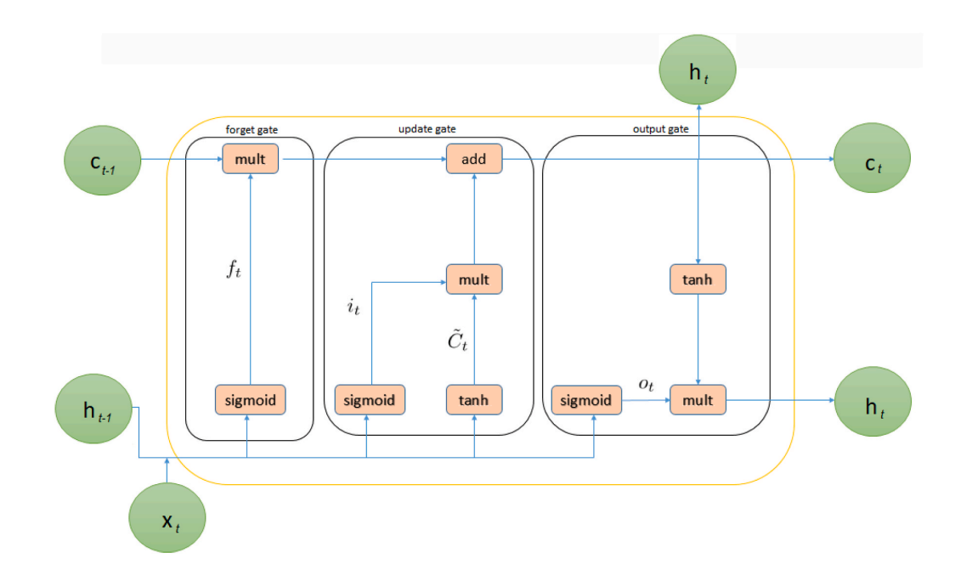
Algorithm with Implementation Details
Fig 3: LSTM Base Model

Slide 18
Algorithm with Implementation Details
Long short term memory (LSTM) is a model that increases the memory of recurrent neural networks.
LSTM networks are a type of RNN that uses special units in addition to standard units. LSTM units include a ‘memory cell’ that can maintain information in memory for long periods of time. This memory cell lets them learn longer-term dependencies.
LSTMs deal with vanishing and exploding gradient problem by introducing new gates, such as input and forget gates, which allow for a better control over the gradient flow and enable better preservation of long-range dependencies.
LSTM is being used along with VGG19 and InceptionV3 to extract features which were previously not being detected in the base model.

Slide 19
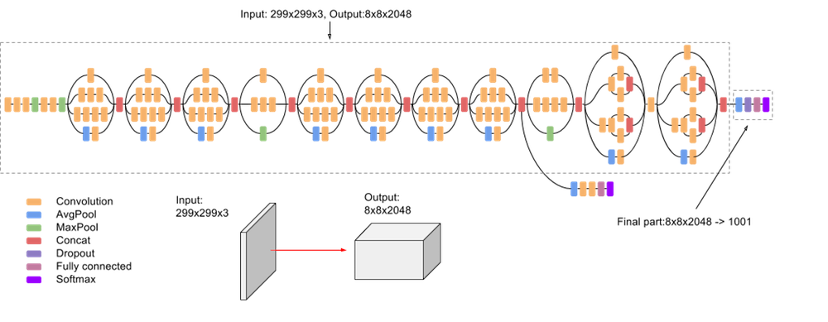
Algorithm with Implementation Details
Fig 4: Inception v3 Base Model
Sigmoid

Slide 20
Algorithm with Implementation Details
Inception v3 mainly focuses on burning less computational power by modifying the previous Inception architectures.it has a total of 42 layers and a lower error rate than its predecessors.
In comparison to VGGNet, Inception Networks (GoogLeNet/Inception v1) have proved to be more computationally efficient, both in terms of the number of parameters generated by the network and the economical cost incurred (memory and other resources)
Inception v3 is a widely-used image recognition model that has been shown to attain greater than 78.1% accuracy on the ImageNet dataset.
The model itself is made up of symmetric and asymmetric building blocks, including convolutions, average pooling, max pooling, concatenations, dropouts, and fully connected layers.

Slide 21
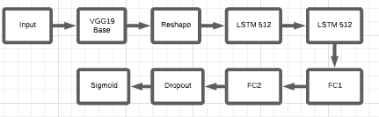
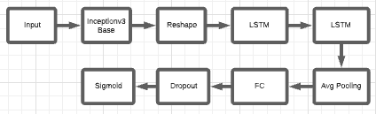
Algorithm with Implementation Details
Fig 4: VGG19 LSTM Model
Fig 5: InceptionV3 LSTM Model

Slide 22
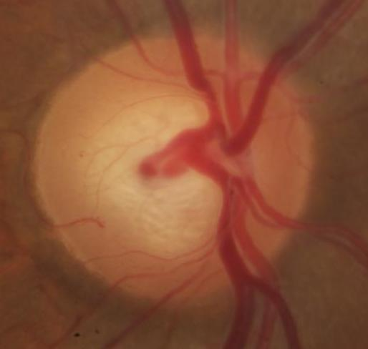
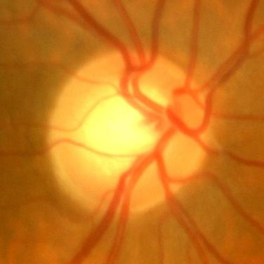
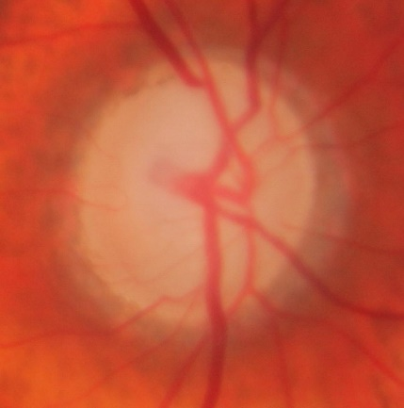
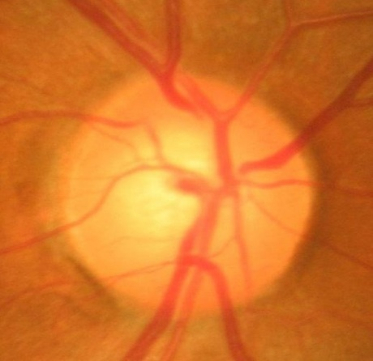
Experimental Setup
Dataset Used:
ACRIMA dataset is being used, and it consists of 705 fundus images (396 glaucomatous and 309 normal images).
632 images are being used for training, and 73 is being used for testing, with a 90-10 split.
Fig 1: Glaucomatous Eye Fig 2: Normal Eye
30/04/2022
Glaucoma Detection and Classification

Slide 23
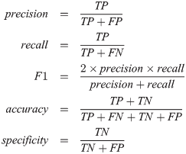
Experimental Setup
Performance evaluation parameters:
Accuracy: It is the proportion of the systems correct predictions for the overall number of predictions. It determines how often the classifier will show the correct output. The ideal value is 1, and the worst case value is 0.
F1-Score: It is an indicator of the accuracy of a model on a dataset. It is used to test binary classification systems that classify examples as “positive” or “negative”. It is the harmonic mean of the precision and recall of the model. The ideal value is 1 ,and the worst case value is 0.
30/04/2022
Glaucoma Detection and Classification

Slide 24
Experimental Setup
Performance evaluation parameters:
Precision: It is the proportion of True Positives divided by the number of True Positive and False Positive. The ideal value is 1 ,and the worst case value is 0.
Recall: Recall is calculated as the number of true positives divided by the total number of true positives and false negatives. The ideal value is 1,and the worst case value is 0.
30/04/2022
Glaucoma Detection and Classification

Slide 25
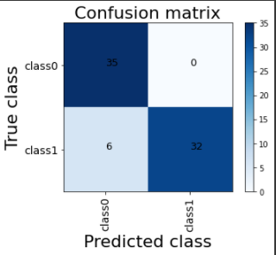
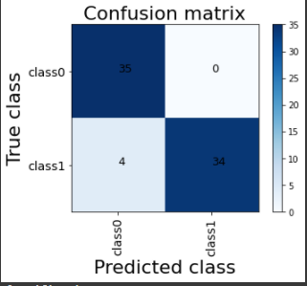
Validation with Test cases
Fig : VGG19 confusion matrix Fig : VGG19 LSTM confusion matrix

Slide 26
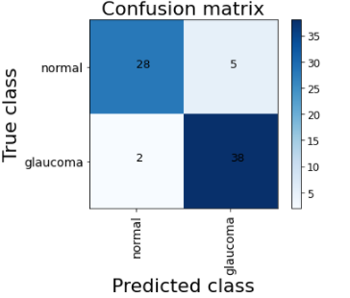
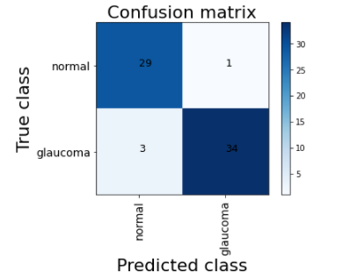
Validation with Test cases
Fig : Inception v3 confusion matrix Fig : Inception v3 LSTM confusion matrix

Slide 27
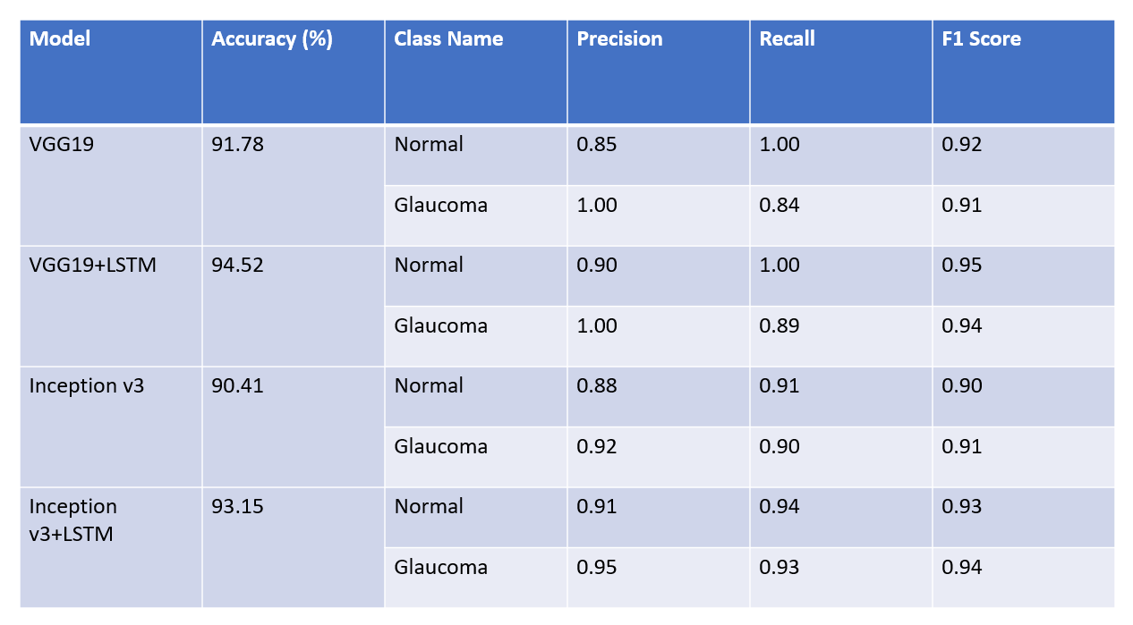
Results and Discussions

Slide 28
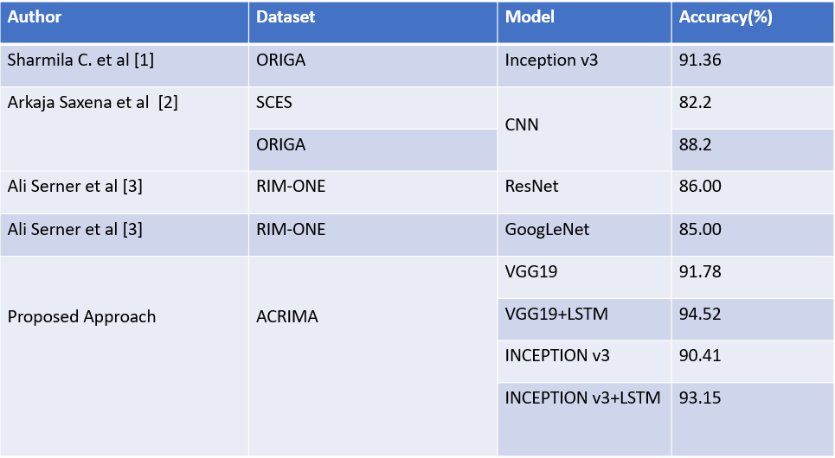
Results and Discussions

Slide 29
Results and Discussions
Test case ID | Test Case( Actions performed) | Expected result | Actual Outcome
1 | Sample from ACRIMA dataset | Normal | Normal
2 | Sample from RIM-ONE dataset | Normal | Glaucomatous
3 | Sample from ACRIMA dataset | Glaucomatous | Glaucomatous
4 | Sample from ACRIMA dataset | Glaucomatous | Glaucomatous
5 | Sample from RIM-ONE dataset | Glaucomatous | Glaucomatous

Slide 30
Results and Discussions
The combination of VGG19 and LSTM achieved the highest performance.
To determine the best performance for each model, we ran several experiments varying the number of epochs, batch size and learning rate.
A batch size of eight, 35 epochs, and a learning rate of 0.0001 were determined as the optimum values to achieve the best performance.
This study demonstrates that extracting spatial features from fundus images using a VGG19 and LSTM, can markedly enhance the accuracy of glaucoma detection.
30/04/2022
Glaucoma Detection and Classification

Slide 31
Conclusion & Future Scope
Globally every year numerous people are affected by a retinal disease, which is known as glaucoma. If not detected early, it causes permanent blindness.
The aim of this project is to provide an effective, fast, and efficient solution for exposure of glaucoma in the eye.
Our proposed model VGG -19 + LSTM predicted two classes (glaucoma and non-glaucoma) with an accuracy of 94.52%.
A model like this will be beneficial to both ophthalmologists and patients.
The potential for future application of this concept is boundless, and it must be studied and pushed to new heights to uncover everything that can be accomplished.
We can try to collect real- life data and wider datasets from hospitals all over India in order to study any changes in the retina due to different geographical locations. Also, we can work on categories based on the severity of Glaucoma.

Slide 32
References
[1] Sharmila C. & Shanthi N.. (2021). Retinal Image Analysis for Glaucoma Detection Using Transfer Learning. 10.1007/978-981-15-9019-1_21.
[2] A. Saxena, A. Vyas, L. Parashar and U. Singh, "A Glaucoma Detection using Convolutional Neural Network," 2020 International Conference on Electronics and Sustainable Communication Systems (ICESC), 2020, pp. 815-820, doi: 10.1109/ICESC48915.2020.9155930.
[3] A. Serener and S. Serte, "Transfer Learning for Early and Advanced Glaucoma Detection with Convolutional Neural Networks," 2019 Medical Technologies Congress (TIPTEKNO), 2019, pp. 1-4, doi: 10.1109/TIPTEKNO.2019.8894965.
[4]Demir F, Taşcı B. An Effective and Robust Approach Based on R-CNN+LSTM Model and NCAR Feature Selection for Ophthalmological Disease Detection from Fundus Images. J Pers Med. 2021 Dec 2;11(12):1276. doi: 10.3390/jpm11121276. PMID: 34945747; PMCID: PMC8709012.

Slide 33
References
[5] Olivas, L.G., Alférez, G.H. & Castillo, J. Glaucoma detection in Latino population through OCT’s RNFL thickness map using transfer learning. Int Ophthalmol 41, 3727-3741 (2021). https://doi.org/10.1007/s10792-021-01931-w.
[6] Tasnim Afroze, Shumia Akther, Mohammed Armanuzzaman Chowdhury, Emam Hossain, Mohammad Shahadat Hossain, and Karl Andersson. (2021). Glaucoma Detection Using Inception Convolutional Neural Network V3. Springer International Publishing. Cham. DOI: 10.1007/978-3-030-82269-9_2
[7] Ajitha S, Dr. M V Judy, Dr. Meera N, Dr. Rohith N. (2020). Automated Identification of Glaucoma from Fundus Images using Deep learning Techniques. European Journal of Molecular & Clinical Medicine. Volume 07, Issue 02, 2020.
[8]A. Sallam et al., "Early Detection of Glaucoma using Transfer Learning from Pre-trained CNN Models," 2021 International Conference of Technology, Science and Administration (ICTSzA), 2021, pp. 1-5, doi: 10.1109/ICTSA52017.2021.9406522.

Slide 34
References
[9]Fu, Huazhu & Cheng, Jun & Xu, Yanwu & Liu, Jiang. (2019). Glaucoma Detection Based on Deep Learning Network in Fundus Image. 10.1007/978-3-030-13969-8_6.
[10]Diaz-Pinto, A., Morales, S., Naranjo, V. et al. CNNs for automatic glaucoma assessment using fundus images: an extensive validation. BioMed Eng OnLine 18, 29 (2019). https://doi.org/10.1186/s12938-019-0649-y.
[11] Garg, H., Gupta, N., Agrawal, R. et al. A real time cloud-based framework for glaucoma screening using EfficientNet. Multimed Tools Appl (2022). https://doi.org/10.1007/s11042-021-11559-8
[12]Xu, Mai & Liu, Hanruo & Li, Yang & Wang, Xiaofei & Jiang, Lai & Wang, Zulin & Fan, Xiang & Wang, Ningli. (2019). A Large-Scale Database and a CNN Model for Attention-Based Glaucoma Detection. IEEE transactions on medical imaging. PP. 10.1109/TMI.2019.2927226.

Slide 35
Thank you :)
Q & A?
30/04/2022
Glaucoma Detection and Classification

Slide 36
Why is Inception v3 good? Inception v3 was trained on ImageNet and compared with other contemporary models, when augmented with an auxiliary classifier(small cnn inserted between layers during training), f, and label smoothing(to prevent overfitting), Inception v3 can achieve the lowest error rates compared to its contemporaries. Higher efficiency. The inception V3 is just the advanced and optimized version of the inception V1 model. It has higher efficiency It has a deeper network compared to the Inception V1 and V2 models, but its speed isn't compromised. It is computationally less expensive.
2 Why is VGG good: VGG19 is an advanced CNN with 19 pre-trained layers and a great understanding of what defines an image in terms of shape, color, and structure. VGG19 is very deep and has been trained on millions of diverse images with complex classification tasks.
EXTRA: To improve model efficiency, reduce the model load:
Try early stopping to prevent overfitting; if your model reaches a peak accuracy, it will stop looking for an even higher accuracy after a specific number of epochs
Train on fewer epochs to cut the processing time
Try a different activation function, like ReLU which only activates certain neurons, making it more efficient compared to sigmoid or tanh and also prevents overfitting
Try dropout so randomly selected neurons are ignored during training, thus creating less network computation
Avoid large pixel images as adding more image clarity doesn’t improve learning much (224 by 224 pixels is standard)
What are weights in a neural network: Weight decides how much influence the input will have on the output. Weights have to be between 0 and 1. Negative weights means increasing the input will decrease the output. 0 weight means input won't make any diff on output. For eg: Dog has features like ears, eyes, nose. If we think nose can be the most distinctive feature we will assign it the highest weight.
Training loss vs validation loss:The training loss indicates how well the model is fitting the training data, while the validation loss indicates how well the model fits new data.
Importance of learning rate,The amount that the weights are update during training.learning rate can impact two things: 1) how fast the algorithm learns and 2) whether the cost function is minimized or not.
An optimizer is a function or an algorithm that modifies the attributes of the neural network, such as weights and learning rate. Thus, it helps in reducing the overall loss and improve the accuracy
See dataset details
See how data is split 90 10
30/04/2022
Glaucoma Detection and Classification
Notes:
add lstm slide

